Slide 1

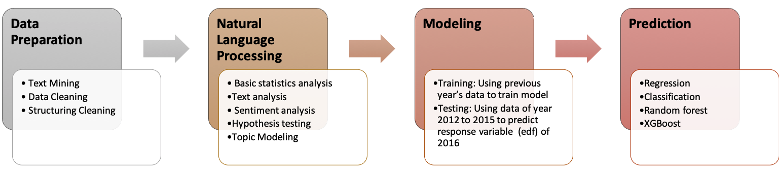
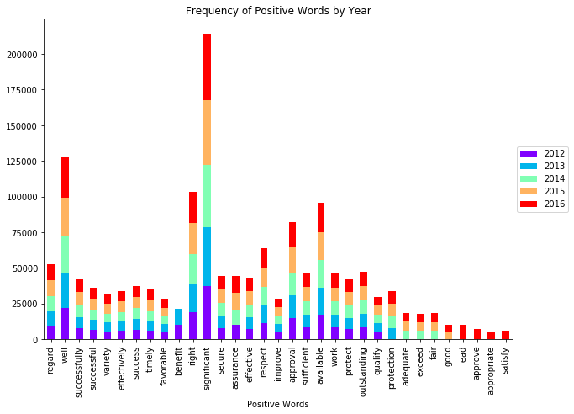
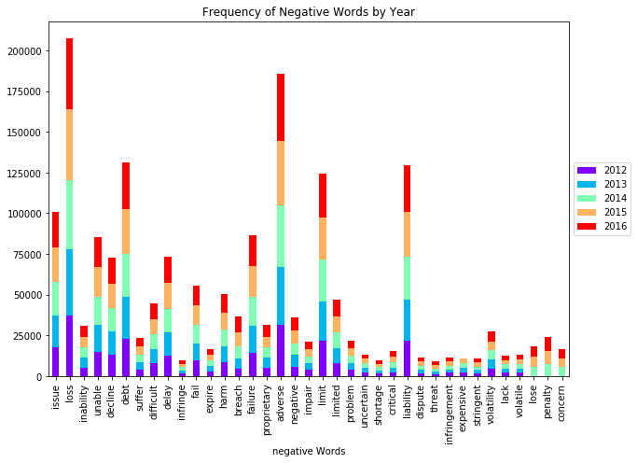
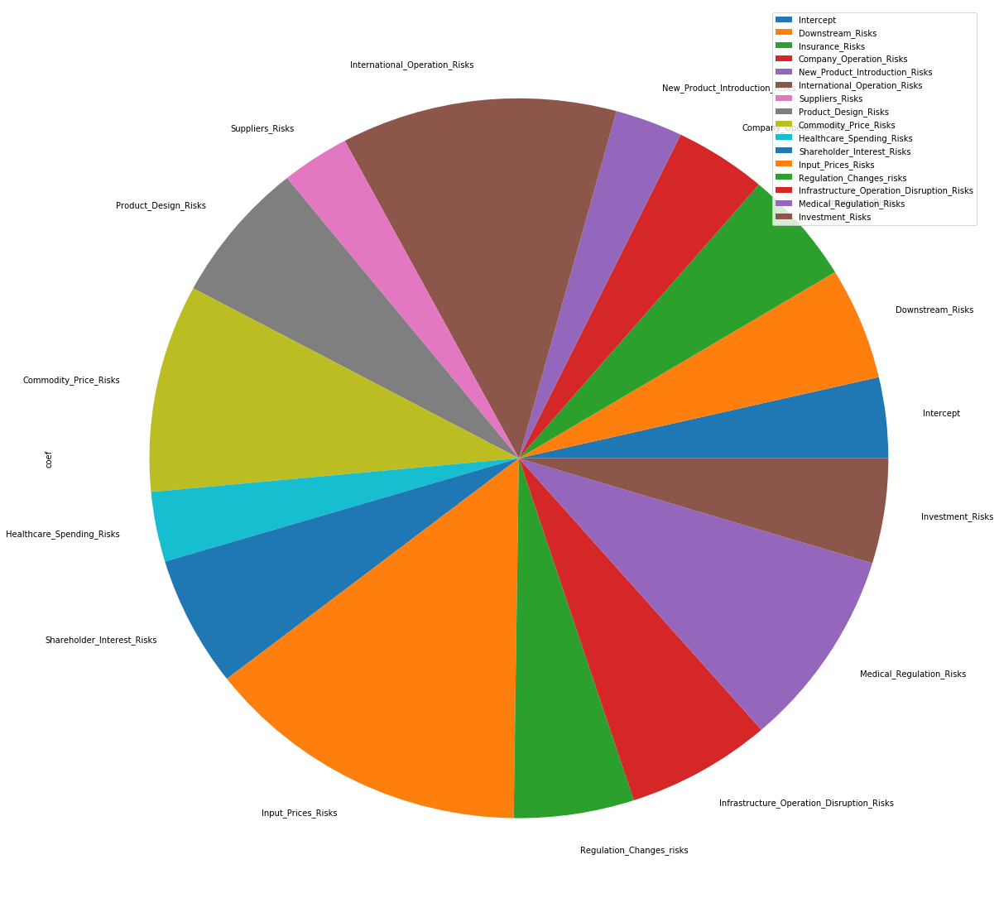
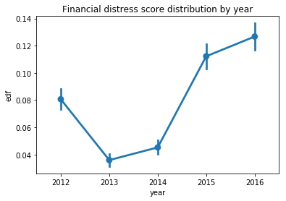
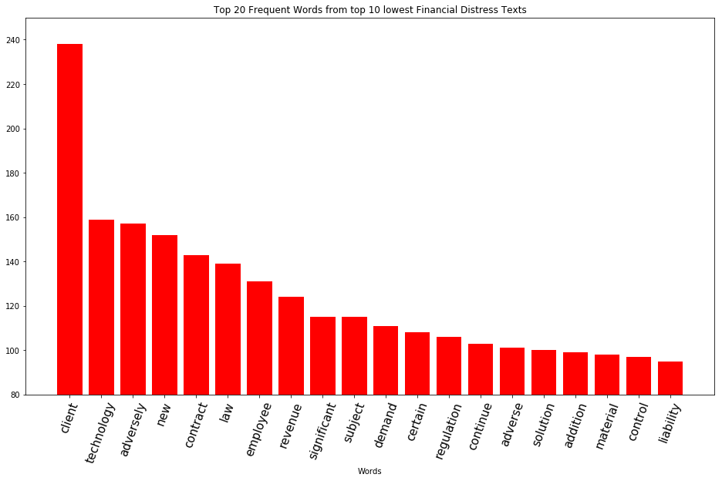
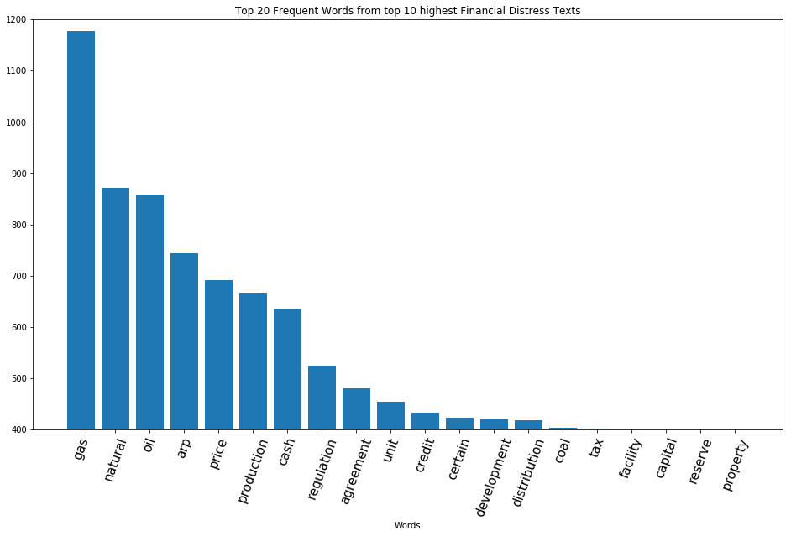
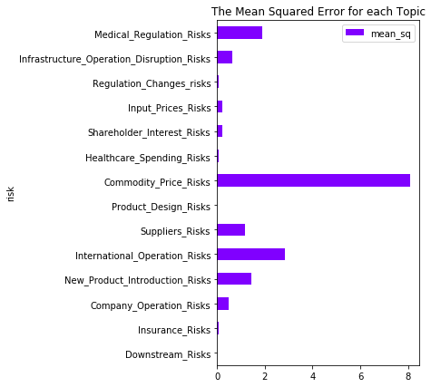
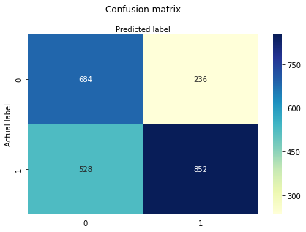
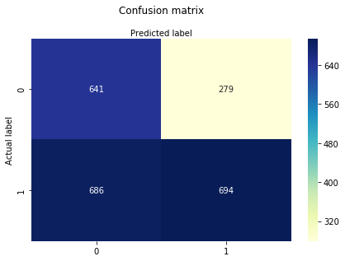
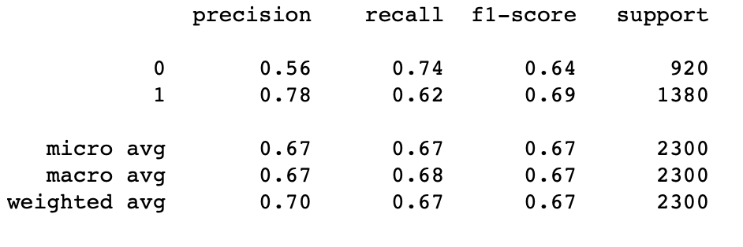
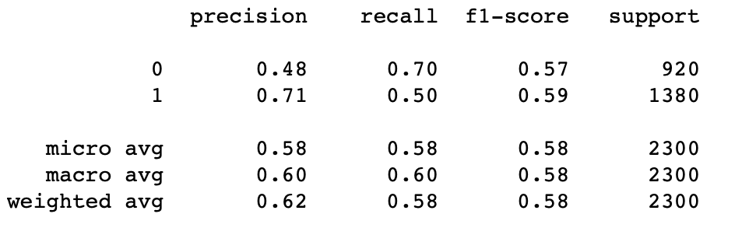
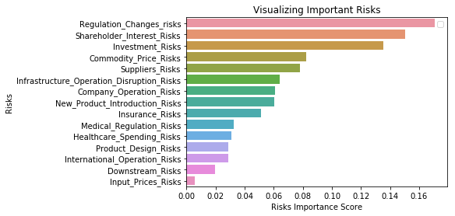
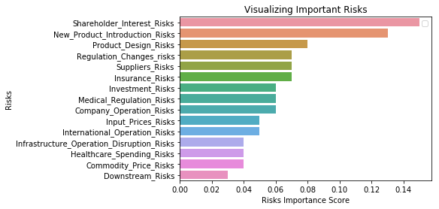
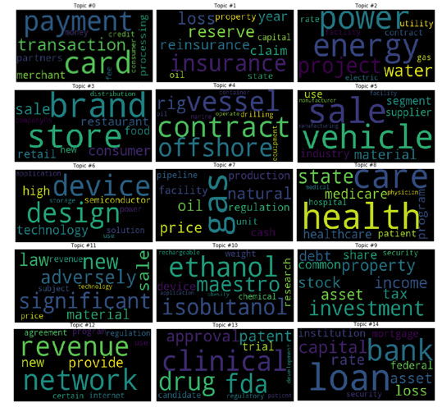
Text Mining 10-K Filling Report
Predict Financial Distress Using Risk Factors
Siwei Wang, Haochen Liu, Yuzhen He, Yiru Yang Instructor: Professor Rong Liu
Business Intelligence & Analytics
Introduction
Motivation: Financial distress indicates a probability a company goes to bankruptcy. Financial distress can be unveiled from several warning signs of company’s financial performance, such as poor profits, negative cash flow, declining relationship with the bank, etc. The “Risk Factor Section” in the 10-K annual report includes company’s explanation of the risks it faces, which contains information regarding future firm fundamentals that is not captured by the quantitative information.
Objective: Improve financial distress (edf) prediction based on risk factors in 10-K filling report from 2012 to 2016.
Key Words: Text Mining, Natural Language Process, Topic Modelling, Predictive Modeling, Python
Project Pipeline
Dataset: 12,103 observations
Yearly Range: 2012 - 2016
Variables:
gvkey: Unique key for each company
year: Year for each 10-K report
edf: Financial distress score
actual_10k_path_raw: Path to documents
risk_factor_text: Scraped ‘Risk Factor’
pandas, Numpy, OS,
Regular Expression
gensim, nltk, matplotlib, seaborn, wordcloud
Scikit-Learn, StatsModels,
RandomForestClassifier
Modeling
Natural Language Process
Sentiment Analysis: Positive/Negative Words Across Years
Prediction model
Model Performance Evaluation
Regression
Random Forest
Classification (Logistic regression)
Financial distress distribution
Point estimates & confidence intervals
New words showed up
Protection: since 2013
Adequate, Exceed, Fair: since 2014
Good: since 2015
Lead, Approve, Appropriate, Satisfy: 2016
New words showed up
Lose, Penalty, Concern: 2016
edf = -0.15381587*T1+ 0.21388551*T2+ 0.21651892*T3+ 0.17162305*T4+0.12565415*T5+0.51262567*T6+ 0.12708051*T7+ 0.27069798*T8 0.39627308*T9+ 0.13350712*T10+0.24905881*T11+0.60673596*T12+ 0.22353962*T13+0.27016046*T14+ 0.37805898*T15+0.20005294*Residual
Hypothesis: Frequent Words VS. Financial Distress
Random Forest
AdaBoost
Low financial distress:
Client service
New technology
Employee-oriented
High financial distress:
Finite resource
Cash flow/capital investment
Regulation
LDA Topic Modeling: Word Cloud for Each Topic
Linear Regression Model - The MS evaluate the significant of each topics.
Conclusion & Future Work
Conclusion
Topic model (15 topics):
After studied the correlation between negative words and edf, we found that generic sentiment analysis using word lists do not add predictive power according to the nature of “Risk Factor” section.
The meaningful results from sentiment analysis is that we observed new words showed up along years
Limitations and future work
Medium correlation coefficient among texts and edf:
The correlation coefficient between sentiment results and edf reveals that only text from ‘Risk Factor’ is not sufficient to support edf. In the future, the research will add both textual and numerical dimensions to explain edf.
For textual dimension, industry of companies will be under consideration. For numerical dimensions, the research will consider to add the text feature we got to the original Moody’s model to investigate whether we can improve the prediction accuracy of financial distress.
0:Downstream Risks | 1:Insurance Risks | 2:Company Operation Risks
3:New Product Introduction Risks | 4:International Operation Risks | 5:Suppliers Risks
6:Product Design Risks | 7:Commodity Price Risks | 8:Healthcare Spending Risks
9. Shareholder’s Interest Risks | 10:Input Prices Risks | 11:Regulation Changes risks
12:Infrastructure Disruption Risks | 13:Regulation Risks | 14:Investment Risks
http://www.stevens.edu/bia

